Slide 1
2024 Missouri Legislative Session
Meghan Travis Henderson
Vice President of Legislative Policy and
Associate General Counsel
St. Louis Area Health Lawyers Association
May 24, 2024

Slide 2
102nd General Assembly
Second Regular Session

Slide 3
The Legislature
There are 163 seats in the House of Representatives. House members are elected to two-year terms and may serve a total of eight years.
  111 Republicans
  52 Democrats
There are 34 seats in the Senate. Senators are elected to four-year terms and may serve a total of eight years.
  24 Republicans
  10 Democrats

Slide 4


Missouri House Leadership
Dean Plocher (R-St. Louis), Speaker — responsible for committee assignments, assigning bills to committee and signing all official actions of the House
Jonathon Patterson (R-Lee’s Summit), Floor Leader — manages actions on the floor

Slide 5

House Minority Leadership
Crystal Quade (D-Springfield), Minority Floor Leader—runs floor actions of minority party

Slide 6
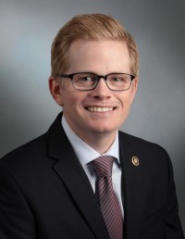
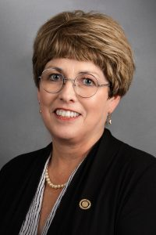
Missouri Senate Leadership
Caleb Rowden (R-Columbia), President Pro Tem — controls procedural functions of the Senate and rules on parliamentary matters
Cindy O’Laughlin (R-Shelbina), Majority Floor Leader — determines which bills will be debated

Slide 7
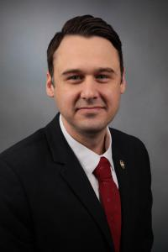
Senate Minority Leadership
John Rizzo (D-Independence), Minority Floor Leader—coordinates actions of minority party

Slide 8

Legislation Truly Agreed and Finally Passed
2017 ⎯ 59
2018 ⎯ 130
2019 ⎯ 75
2020 ⎯ 31
2021 ⎯ 49
2022 ⎯ 44
2023 ⎯ 41
2024 ⎯ 28
*Count excludes budget bills

Slide 9
Legislators Running Statewide
Governor
  Sen. Eigel
  Rep. Quade
Lieutenant Governor
  Sen. Thompson Rehder
  Sen. Hough
  Rep. Brown
U.S. Senate
  Rep. May
Secretary of State
  Sen. Coleman
  Sen. Hoskins
  Rep. Plocher
  Rep. Schwadron
Treasurer
  Sen. Koenig
  Rep. Smith
U.S. House
  Rep. Hicks

Slide 10
General Assembly Primaries
Senate 3 (Gannon) —Reps. Henderson and Buchheit-Cortway
Senate 7 (Razer) — Rep. Patty Lewis
Senate 11 (Rizzo) — Reps. McMullen and Sauls
Senate 13 (Mosley) – Re. Nickson-Clark challenging Mosley
Senate 17 (Arthur) — Rep. Nurrenbern
Senate 21 (Hoskins) — Reps. Richey and Gregory
Senate 23 (Eigel) — Reps. Christofanelli and Schnelting
Senate 27 (Rehder) — Reps. Dinkins and Burger
Senate 31 (Brattin) — Reps. Haffner and Houx challenging Brattin
Senate 33 (Eslinger) — Reps. Hudson and Smith

Slide 11
2024 Legislative Session
The General Assembly convened Wednesday, Jan. 3 and adjourned Friday, May 17.
The Senate did not pass a bill for the first seven weeks.
At the beginning of the last week of session, only 14 non-appropriations bills had been sent to the Governor.
The legislature ultimately passed 28 bills, beating the previous record of only 31 bills (2020).

Slide 12
An Extraordinary Session
Freedom Caucus
Filibusters and abrupt adjournments
Federal Reimbursement Allowance (FRA)
No conferencing on bills, including the budget
Lies, falsehoods and not even half truths
No conference committees – not even on the budget
Shenanigans

Slide 13
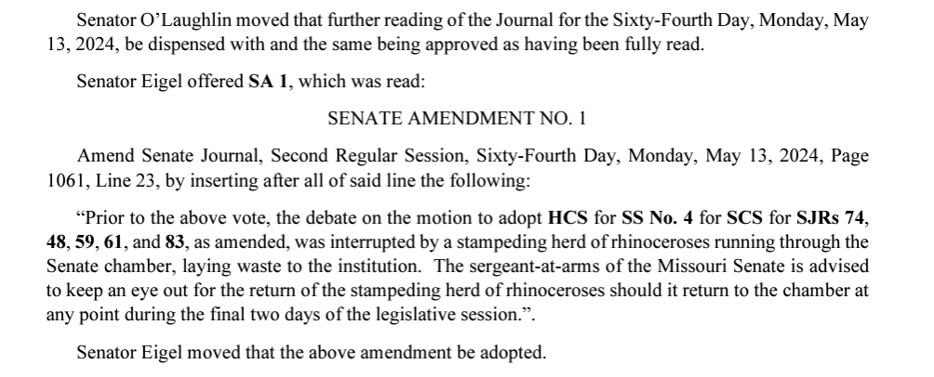
Exhibit A

Slide 14
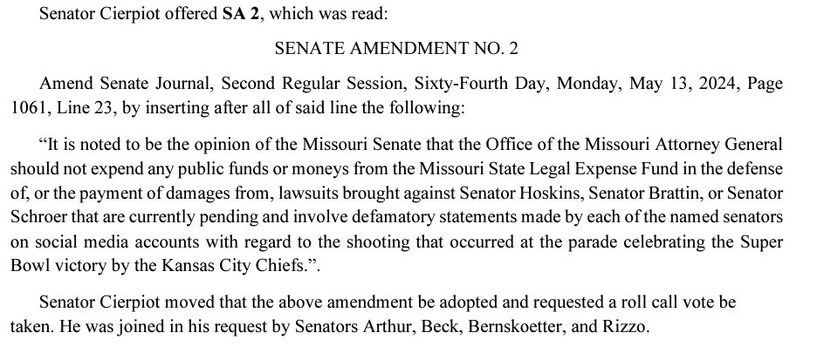
Exhibit B

Slide 15
TAFP Legislation

Slide 16
Abortion Facilities and Affiliates
HB 2634
Prohibits the expenditure of public funds, including MO HealthNet reimbursement, to any abortion facility or any affiliate thereof
Grants standing for suit to any taxpayer and the Attorney General to enforce the provisions of the bill in any court or administrative agency of competent jurisdiction
Disqualifies an abortion provider or its affiliate from a contract or provider agreement with the Department of Social Services
Signed by the Governor on May 9th

Slide 17
Federal Reimbursement Allowance
SB 748
Renews the federal reimbursement allowance for ground ambulances, nursing facilities, Medicaid managed care organizations, hospitals, pharmacies, and intermediate care facilities for the intellectually disabled
5-year extension that expires September 30, 2029
Tax of $1.27 billion that draws down over $3 billion in federal funds
Reauthorized 16 separate times since enactment in 1992

Slide 18
Pediatric Extended Care Facilities
SB 1111
Defines “prescribed pediatric extended care facility" as a facility providing medically necessary multidisciplinary services to children under 6 years of age with complex medical needs requiring continuous skilled nursing intervention of at least 4 hours a day under a physician's order.
  Multidisciplinary services may include skilled nursing, personal care, nutritional assessment, developmental assessment, and speech, physical, and occupational therapy.
Requires prescribed pediatric extended care facilities to also be licensed child care providers under state law.

Slide 19
Pediatric Extended Care Facilities
Sets forth a regulatory scheme including licensure, inspection, investigations, and general compliance requirements.
Excludes from licensure any prescribed pediatric extended care facilities with caregiver staffing ratios of one licensed nurse present for every child present; hospitals, sanitariums, or homes operated for medical treatment or nursing or convalescent care for children; and certain Department of Mental Health-licensed programs.

Slide 20
County Hospitals
SB 1359 (Sections 205.160, 205.190)
Currently, county commissions are authorized to establish, construct, equip, improve, extend, repair, and maintain public hospitals, engage in health care activities, and issue bonds in another county, except in counties of the third and fourth classification where there already exists a city, county, township, or hospital district hospital.
This bill removes the exception for city and hospital district hospitals in counties of the third and fourth classification, meaning county commissions are authorized to take the above referenced actions except in counties of the third and fourth classification where there already exists a county or township hospital.

Slide 21
County Hospital Investments
SB 1359 (Section 205.165)
Currently, the board of trustees of any hospital may invest up to 15% of their unobligated funds into any mutual funds in the form of an investment company, a variety of stocks, bonds, and money-market investments. This applies to a hospital located in Boone County that receives less than 1% of its annual revenue from county or state taxes.
This bill removes the requirement that the hospital be in Boone County, and permits such investment if the hospital receives less than 3% of its annual revenue from county or state taxes.
The bill removes the general 15% restriction for investment purposes and delineates a permissible structure and method for the investment of hospital funds.

Slide 22
MO HealthNet Cancer Screenings
SB 1359 (Section 208.151)
Ensures MO HealthNet coverage for treatment of women who’ve received a breast or cervical cancer screening that would be covered under Title XV of the Public Health Services Act and who otherwise meet eligibility requirements for MO HealthNet medical assistance.

Slide 23
Dental Plan Reimbursement
SB 1359 (Section 376.427)
Subjects payments made under the assignment of benefits statute to Missouri’s prompt pay requirements.
Entities not currently subject to Missouri’s prompt pay statute are required to comply beginning January 1, 2026.

Slide 24
Health Insurer Reimbursement to Providers
SB 1359 (Section 376.1345)
Currently, if a health carrier initiates or changes the method used to reimburse a health care provider to a method that requires the provider to pay a fee or remit some other form of remuneration, the carrier must notify the provider of the cost, provide clear instructions as to how to select an alternative payment method, and use that alternative method if requested by the provider.
This bill requires the health carrier or entity acting on its behalf to first receive approval from the health care provider before reimbursing the health care provider with such payment method.

Slide 25
340B Nondiscrimination and White Bagging
SB 751 (Brown 16), HB 2267 (Peters)
Prohibits insurers and pharmacy benefits managers from forcing white bagging upon patients and their healthcare providers
  Only applies to clinician-administered drugs
Prohibits insurers and PBMs from discriminating against a covered entity based on such entity’s participation in the 340B program
  Cannot pay differently or subject to different requirements or standards than those imposed upon similarly situated facilities
Prohibits pharmaceutical manufacturers from limiting delivery of 340B drugs to a pharmacy that is contracted with a covered entity
Requires insurance coverage of all biosimilars to a reference product in the same manner the reference product is covered

Slide 26
340B Nondiscrimination and White Bagging
SB 751 (Brown 16), HB 2267 (Peters)
Prohibits insurers and pharmacy benefits managers from forcing white bagging upon patients and their healthcare providers
  Only applies to clinician-administered drugs
Prohibits insurers and PBMs from discriminating against a covered entity based on such entity’s participation in the 340B program
  Cannot pay differently or subject to different requirements or standards than those imposed upon similarly situated facilities
Prohibits pharmaceutical manufacturers from limiting delivery of 340B drugs to a pharmacy that is contracted with a covered entity
Requires insurance coverage of all biosimilars to a reference product in the same manner the reference product is covered

Slide 27
340B Contract Pharmacies
SB 751
Prohibits pharmaceutical manufacturers, third-party logistics providers, and any agent or affiliate thereof from restricting the acquisition or delivery of 340B drugs to pharmacies that are under contract with a covered entity to receive and dispense 340B drugs on behalf of the covered entity.
Violation of the bill are an unlawful merchandising practice, and each package of 340B drugs affected, as defined by federal law, shall constitute a separate violation.
The Board of Pharmacy may investigate and impose discipline for violations of these provisions.

Slide 28
Failed Legislation

Slide 29
Prior Authorization Reform
HB 1976 (Stinnett)
Eliminates insurer prior authorization for health care providers who’ve received 90% approval of all prior authorizations for a specific health care service in the prior six months (gold carding) or for all health care services in the prior six months (platinum carding)
Requires insurers to create an online portal for providers to access their gold/platinum carding status and for providers without gold/platinum carding to seek prior authorization
Includes Medicaid managed care organizations

Slide 30
Sexual Assault Nurse Examiners
SB 1326 (McCreery)
Currently, any hospital licensed in Missouri must employ 24-hour SANE coverage or participate in the state’s SANE telehealth program for treatment of victims of sexual assault
The bill removes specialty hospitals from these requirements if such hospital has in place a policy for the transfer of victims of sexual assault to an appropriate hospital with an emergency department
Under the bill, a specialty hospital is a hospital designated as anything other than a general acute care hospital by the Department of Health and Senior Services

Slide 31
Board of Registration for the Healing Arts
HB 2753 (Keathley), SB 1030 (Eslinger)
Streamlines physician licensure applications in Missouri
Requires BOHA to obtain background checks on applicants
Requires applicants to submit a medical school diploma and supporting academic transcripts and proof of completion of a postgraduate internship or residency program
Allows BOHA to require applicants list previous and existing medical licenses in other states, territories, and countries
Deems an applicant licensed in good standing if BOHA fails to approve/deny an application within 45 days of receipt of the application
Permits licensure of certain highly trained physicians without access to an accredited residency program

Slide 32
Advanced Practice Registered Nurses
HB 2217 (Keathley), SB 807 (Black)
Deletes geographic proximity requirements from statutes governing APRN/physician collaboration
Declares void any regulation mandating geographic proximity in collaborative practice arrangements and deems such provisions unenforceable

Slide 33
Hospital Price “Transparency”
HB 1837 (McMullen), SB 1212 (Moon)
Prohibits a hospital from collecting bad debt if the hospital is not in material compliance with federal hospital price transparency laws
Creates a private cause of action to enforce
Creates another cause of action for any person who pays a hospital bill for a good or service that is more than the cost price published for that good or service under federal hospital price transparency laws

Slide 34
Physician Covenants Not to Compete
HB 2754 (Keathley), HB 2725 (Mackey), SB 1396 (Fitzwater)
Limits enforceable covenants not to compete in physician employment
Only enforceable if physician provides health care services in a clinical setting
AND
Employer is a health care entity that is not owned or operated by a 501(c)(3) nonprofit corporation
Limits all enforceable non-competes to a duration of 365 days and 50 miles from the physician’s office

Slide 35
Health Care Workplace Violence
HB 2556 (Hicks), SB 1385 (Schroer)
Prohibits requiring an employee of a health care facility to physically engage with a person exhibiting violent tendencies if there is a reasonable fear of bodily harm to the employee
Prohibits a health care facility from requiring certification or training that limits physical control or restraint of patients to certain holds or positions
Prohibits a state agency or any accrediting body from requiring such training

Slide 36
Health Care Workplace Violence, Cont.
Removes liability for a health care facility or its employee acting in good faith and without gross negligence for the escape of a violent patient who posed a risk of bodily harm to others
  Does not apply if the patient is a minor or is known to the facility and staff as having a diagnosis of dementia, acute brain injury, acute non-drug-related psychosis, or an intellectual or developmental disability
Allows a nurse to terminate participation in a patient’s care without consequence if the nurse is subject to assault or battery by the patient or an individual acting on behalf of the patient so long as the person is of sound mind or intoxicated at the time of the assault or battery

Slide 37
Health Care Workplace Violence, Cont.
Requires law enforcement officers to first take an individual in their custody to jail or prison for evaluation if the individual expresses intent to harm him/herself but does not have a medical emergency
  If hospital admission is recommended after evaluation and an inpatient bed is available, LEO may transfer the individual to the accepting hospital
Requires loss of licensure or registration if a facility violates these provisions
Prohibits state agency recognition of any accrediting body that violates these provisions

Slide 38
Emergency Department Staffing
HB 2548 (Christ)
Requires a physician to be physically located inside the emergency department at all times the emergency department is open

Slide 39
Hospital Visitation
HB 2869 (Lewis)
Modifies 2022 legislation
Strict liability for a hospital, long-term care facility, or hospice that violates any provisions of the Compassionate Care Visitation Act/No Patient Left Alone Act
Suspension or revocation of license/certificate by DHSS
Civil monetary penalty of $1,000 for each day of such violation
Required enforcement by the attorney general; permissive enforcement by DHSS
Awards attorneys fees to the state

Slide 40
Human Trafficking Training
HBs 1706 & 1539 (Myers)
Establishes the Committee on Sex and Human Trafficking
  Must establish training guidelines and produce a digital training platform
Requires EMTs to receive 4 hours of prescribed training every 5 years
Requires social workers to receive 2 hours of prescribed training every 2 years before license renewal
Requires RNs, LPNs, and APRNs to receive 1 hour of prescribed training annually prior to license renewal
Training provisions effective Jan. 1, 2025 through December 31, 2029
Also enhances penalties, creates fines, and modifies victim classifications and protections for minors and vulnerable persons

Slide 41
Looking Ahead
Bills that are “truly agreed and finally passed” are submitted to the governor for signature
The governor may line-item veto budget bills, but only may veto substantive legislation in its entirety
Bills must be signed 45 days after the legislature adjourns
Laws are effective on August 28, unless a later date is provided for in the legislation. Bills cannot take effect prior to August 28 without an emergency clause, which requires a 2/3 vote in each chamber.

Slide 42
Questions?

Slide 43
Contact Information
Meghan Travis Henderson
Vice President of Legislative Policy and Associate General Counsel
mhenderson@mhanet.com
573-893-3700, ext. 1389

